Slide 1

The Writing Process

Slide 2

An Overview
Any well written document gets the job done and makes you look good
Generating Information
Prewrite: Spend quality time prior to writing
Consider needs of audience
Choosing the communication channel
Choosing the communication channel
Write: Stating gathered data/information
Test for usability
Rewrite: Revise the rough draft
Perfecting your document

Slide 3
Prewriting
Both internal or external
To inform, instruct or persuade and build trust
Choosing communication channel according to audience and purpose
Gathering data

Slide 4

Writing
Organize content according to pattern
Use figures and tables to clarify content
Format the content for ease of access

Slide 5

Rewriting
Test for usability
Adding details
Deleting wordiness
Simplifying words
Enhancing the tone
Reformatting your text
Proofreading and correcting errors
Revise your draft
Format the content for ease of access

Slide 6
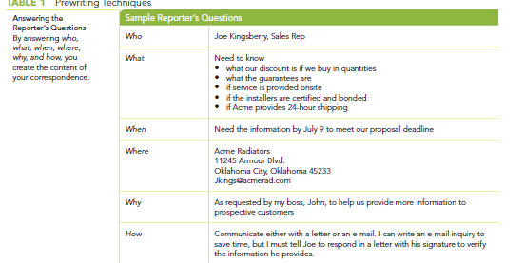
Reporter’s Questions
Helps create content for correspondence

Slide 7
Choosing a Tone for the Reader
Personal
◗◗Use the active voice.
◗◗Use first names.
◗◗Use personal pronouns.
◗◗Use short sentences.
◗◗Use contractions.
◗◗Direct questions at the reader.
Impersonal
◗◗Do not use names, especially first names.
◗◗Do not use personal pronouns.
◗◗Use the passive voice.
◗◗Use longer sentences.

Slide 8
Choosing a Tone for the Reader
Personal
Ted, thanks for that laptop suggestion. The steering committee loved it. Like you, we feel it will solve the eyestrain issue and will facilitate data flow. And we think it will also raise morale. I’d like you to begin work on this soon. Can you make an appointment to see me this week?
Impersonal
A decision to provide each employee with a laptop has been made. Laptops will reduce the eye fatigue that some employees have experienced, and the laptops will increase data flow. Ted Baxter will chair the implementation committee. Donna Silver and Robert Sirabian will assist. The committee will hold its initial meeting on Monday, October 10, at 3:00 p.m. in Room 111.

Slide 9
Which tone is this?
Ted, thanks for the laptop suggestion, but we can’t do it this cycle. The steering committee understands the ergonomic issue you raise, but they are very concerned
about the disruption that migrating all those files will cause. In addition, they feel that we need to work out the entire issue of footprint—the model you suggested would cause a number of problems with current desk configurations. I know that this is a disappointment. Could we get together soon to discuss this?
Passive

Slide 10
Ambiguous language: Examples
“A hazard exists if contact is made with this part while it is whirling.”
not urgent or specific enough to help a user prevent injury.
“When I click the ‘Submit’ button, it doesn’t work.”
Imprecise phrasing
I am not responsible. It is your job. I will not take the time and effort to right this, whatever inconvenience it may cause you.”
refusal to take responsibility

Slide 11
Use Clear, Direct expression
Jargon, shop talk, or technobabble that marginalizes or excludes the reader or audience is not only
confusing, it is unethical.
If there is a confirmation of the tank level rising, a determination of the source should be made.
Determine if the tank level is rising. Visually check to see if liquid is coming out of the first-floor trench.

Slide 12
Activity (Pair work)
Write a social media campaign post (you can be creative, and it can be of a social, cultural or environmental nature) for a company keeping in mind the conventions of sentence structure and organization for a small paragraph that we have discussed so far. Address reporter’s questions before drafting the post. Your final draft for the post must not be more than 100-150 words. In addition to writing it, chalk out details like the suitable layout, tone and hashtags for gathering attention on socials. Mention the tone chosen before the start of the rough draft as well.
Prepare the answers to reporter’s questions and a rough draft for the post in a word document before Friday’s class.

